Slide 1
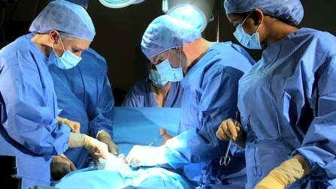
INTRODUCTION TO SURGERY
KMTC – BONDO CAMPUS SERIES

Slide 2
Definition
Surgery is the branch of medicine that deals with the physical manipulation of a bodily structure to diagnose, prevent, or cure an ailment. It also refers to performance of such procedures by a surgeon

Slide 3
Surgery is a procedure that involves cutting of a patient's tissues or closure of a previously sustained wound.
(Or)
Surgery is defined as the treatment of injuries or disorders of the body by incision or manipulation, especially with instruments.

Slide 4
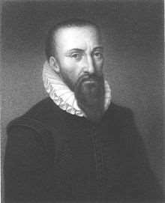
Why do we need to perform surgery In 16th century, a French surgeon named Ambroise Pare, stated that there were five reasons to perform surgery. These are to:
Eliminate that which is superfluous
Restore that which has been dislocated
Separate that which has been united
Join that which has been divided
Repair the defects of nature

Slide 5
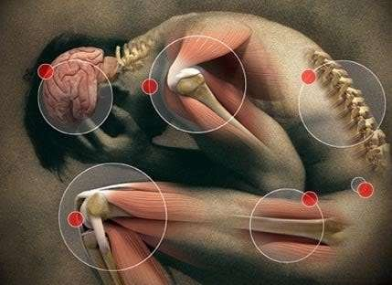
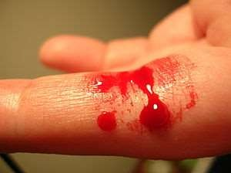
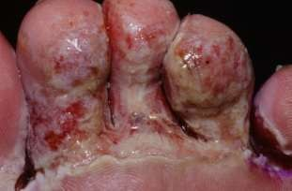
3 major obstacles in surgery
Up until the industrial revolution, surgeons were incapable of overcoming three principal obstacles which had plagued the medical profession from its infancy. These obstacles are:
Pain
Bleeding
Infection
Advances in these fields have transformed surgery from a risky "art" into a scientific discipline capable of treating many diseases and conditions.

Slide 6
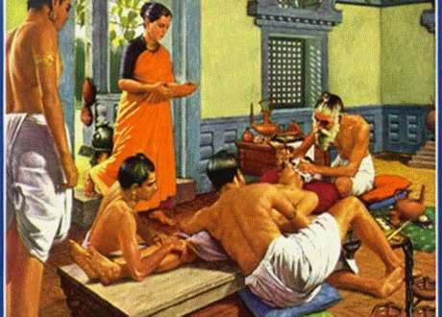
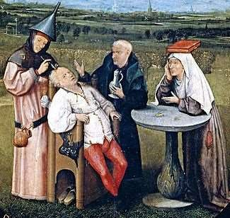
History of surgery
The first surgical techniques were developed to treat injuries and traumas.
It involved suturing lacerations, amputating insalvageable limbs, and draining and cauterizing open wounds.
Oldest surgery that is evidenced is trepanation (burrholes or craniotomy) – BC Setting bones and splinting, intramedullary fixation with wooden splints is reported in early spanish texts
Anaesthesia using alcohol or opium is one of the oldest surgical techniques reported

Slide 7
Pain
Cauterization
Ligatures
Infection
Spread through contamination – Ignaz
Washing hands - aseptic techniques – Lister
Antibiotics – Louis Pasteur
Anaethesia – Dentist Horace Wells (1840)
Ether, chloroform – John Snow
Muscle relaxants e.g. curare

Slide 8
Ancient History
Earliest known – Trepanation (trephining) Kiev – Ukraine – 7300 – 6220 B.C
Ancient Egyptian pyramids – discovery of brain surgery

Slide 9
Edwin Smith Papyrus – 1600 B.C
Susrutha – 400 B.C – Father of surgery Susrutha samhitha
Ancient Greek – Hippocrates & Galen

Slide 10
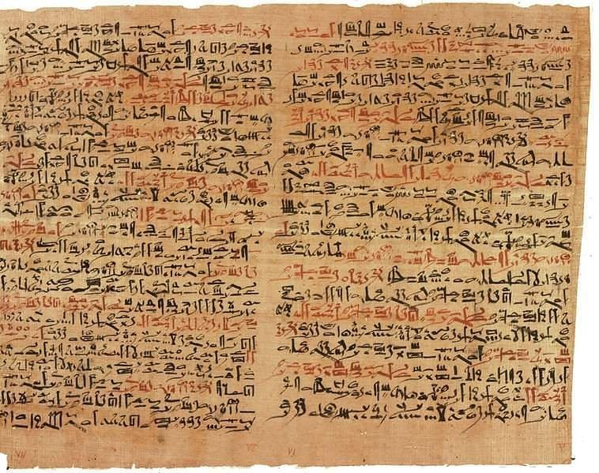

Slide 11
Medieval Surgery
Decline of surgery in the west by 13th century
Physicians higher status
Barbers & monks – self qualified surgeons

Slide 12
Medieval Surgery
Rogerius Salernitanus -1180 A.D – Chirurgiae
Surgical therapy – amputations , drainage of abscess,scarification, leeching etc

Slide 13
Ambroise Pare`
John Hunter

Slide 14
Birth of modern surgery
Louis Pasteur > Germ theory
Ignaz Semmelweis > Washing hands →
↓Puerperal sepsis
Joseph Lister > Sterile surgery
Principles of practice of surgery(March 16, 1867) . “Father of modern antisepsis”

Slide 15
Birth of modern surgery
King Edward VII – “ I know that if it had not been for you and your work, I would not have been sitting here today”
T.G.Morton – Boston dentist -1846
>Anaesthesia

Slide 16
Modern Surgery
William Stewart Halsted(1852 – 1922)
1.sterile rubber gloves
2. new surgery, based on anatomic, pathologic, and physiologic principles and employing animal experimentation.

Slide 17
William Stewart Halsted(1852 – 1922)
3. Modern operating theater.
4. Residency scheme of training surgeons

Slide 18
Theodore Billroth (1881)– gastrectomy
Langenbuch (1882) – cholecystectomy
Synmonds (1883) - Appendicectomy

Slide 19
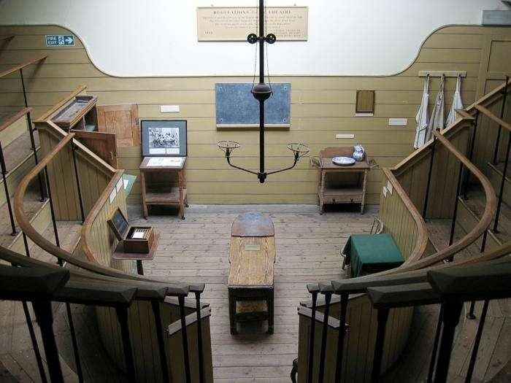

Slide 20
Modern Surgery
4 major advancements in related disciplines helped the advancement of surgery are:
Knowledge of Anatomy
Discovery of Anaesthesia
Intraoperative haemostasis
Concepts of asepsis

Slide 21
Modern Surgery
20th century surgery land marks
Improved understanding of shock
Knowledge of blood group & blood transfusion techniques

Slide 22
Understanding of blood clotting
Development of antibiotics & analgesics

Slide 23
Modern Surgery
Electrically powered surgical instruments, surgical stapling instruments, surgical glues, tapes etc.
Xrays &scans

Slide 24
Cryogenic super cooled probes
Ultrasonic devices, Medical Lasers
Heart lung machines, hypothermia, transplantation of organs

Slide 25
Modern Surgery
Orthopaedics – cementing substances, bone & joint replcements
Microsurgery
Minimally invasive surgery
Vascular imaging, Angioplasty

Slide 26
Surgical disorders
Trauma
Anatomical abnormalities
Disorders of function
Inflammation
Ischaemia & infarction
Metabolic disorders
Neoplasia
Cysts, hyperplasia, hypertrophy

Slide 27
According to 1996 data, US – National centre for Health Statistics –40.3 million I.P surgeries &31.5 million O.P.surgeries

Slide 28
Classification Divisions of Surgery – very many General Orthopaedic
Peadiatric
Cardiothoracic and Vascular
Plastic or reconstructive
Maxillofacial
Gastroenteric
Neurosurgery
Urology

Slide 29
Types of surgeries
Classification cont…
Diagnostic, exploratory, reconstructive, curative, pariative, transplant, elective, urgent, emergency
According to magnitude Major, medium, minor

Slide 30
TYPES OF SURGERY
Surgical procedures are classified based On
Urgency
Risk and
Purpose

Slide 31
SURGERY BASED ON URGENCY
Elective surgery
Urgent surgery
Emergency surgery

Slide 32
ELECTIVE SURGERY
It is a procedure that is pre planned and based on patients choice and availability of scheduling for the patient, surgeon and the facility.
Delay of surgery has no ill effects.

Slide 33
ELECTIVE SURGERY
Examples:
Hernia repair
Cataract extraction
Tonsillectomy
Hip prosthesis

Slide 34
URGENT SURGERY
Must be done with in a reasonably short time frame to preserve health. Usually done with in 24 – 48 hours
Examples
Removal of gall bladder
Amputation
Appendectomy

Slide 35
EMERGENCY SURGERY
Must be done immediately to preserve life, a body part or function.
Examples
Control of haemorrhage
Repair of trauma ,perforated ulcers , intestinal obstruction.

Slide 36
SURGERY BASED ON DEGREE OF RISK
Major surgery
Minor surgery

Slide 37
MAJOR SURGERY
Major surgery requires hospitalization and specialized care, is usually prolonged, has a higher degree of risk, involves major body organs or life threatening situations, and has a greater risk for postoperative complications.

Slide 38
MAJOR SURGERY
Examples.
Open Cholecystectomy
Nephrectomy
Hysterectomy
Radical mastectomy
Laparotomy

Slide 39
MINOR SURGERY
Minor surgery is usually brief, carries a low risk and results in few complications.
Minor surgeries are mostly elective.
Examples
Teeth extraction
Cataract extraction

Slide 40
SURGERIES BASED ON PURPOSE
Diagnostic
Ablative
Palliative
Reconstructive
Transplantation
Constructive

Slide 41
1. DIAGNOSTIC SURGERY
Surgeries to make or confirm a diagnosis
Examples
Biopsy
Broncho Scopy
Endo Scopy

Slide 42
2. ABLATIVE SURGERY
Surgeries To remove a diseased body part.
Examples
Appendectomy
Amputation

Slide 43
3.PALLIATIVE SURGERY
Surgeries to relieve or reduce intensity of an illness. It is not curative.
Examples.
Colostomy
Nerve root resection

Slide 44
4. RECONSTRUCTIVE SURGERY
Surgeries to restore function to traumatized or malfunctioning tissue or to improve self concept.
Examples.
Scar revision
Plastic surgery
Internal fixation of a fracture
Breast reconstruction

Slide 45
5.TRANSPLANTATION SURGERY
Surgeries to replace organs or structures that are diseased or malfunctioning
Examples
Kidney, liver, heart transplantation.

Slide 46
6.CONSTRUCTIVE SURGERY
Surgeries To restore functions in congenital anomalies.
Examples
Cleft lip Repair
Closure of Atrial Septal Defect

Slide 47
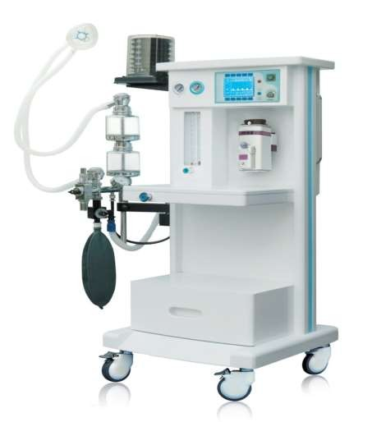
ANAESTHESIA

Slide 48
DEFINITION
Anaesthesia is a temporary state that causes unconsciousness, loss of memory, lack of pain and muscle relaxation

Slide 49
TYPES OF ANAESTHESIA
–Local Anaesthesia
–General Anaesthesia
–Regional Anaesthesia
–Conscious sedation

Slide 50
LOCAL ANAESTHESIA
Local anaesthesia involves the injection of local anaesthetic into the tissues near the surgical site.
It is usually used for minor surgery, such as toe nail repair, skin lesion or a cut to remove something (Biopsy).
Examples of local anaesthetics
LIDOCAINE
LIGNO CAINE

Slide 51
GENERAL ANAESTHESIA
General anaesthesia involves the patient being put into a medication-induced state in which the patient will not respond to pain and includes changes in breathing and circulation.
Under general anaesthetic, a patient is in a state of carefully controlled unconsciousness.
Examples of general anaesthetics
Halothane
Nitrous oxide+ oxygen

Slide 52
REGIONAL ANAESTHESIA
Regional anaesthesia involves the injection of local anaesthetic around major nerve bundles.
Once local anaesthetic is injected in the desired region, patients may experience numbness and tingling in the area supplied by the nerves and it may become difficult or impossible to move that part of the body.

Slide 53
REGIONAL ANAESTHESIA
Epidural anaesthetic - a type of regional anaesthetic usually used to numb the lower half
of the body and good for pain relief - for example, during labour and childbirth.

Slide 54
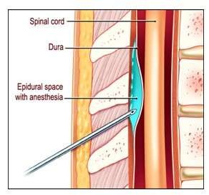
REGIONAL ANAESTHESIA

Slide 55
REGIONAL ANAESTHESIA
Spinal anaesthetic - a type of regional anaesthetic used to give total numbness lasting about three hours to the lower parts of the body so that surgery can be safely carried out in this area
Examples of regional anaesthetics
Lidocaine
Lignocaine
Bupivacaine
Tetracaine

Slide 56
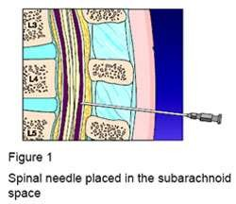
REGIONAL ANAESTHESIA

Slide 57
CONSCIOUS SEDATION
Conscious sedation is defined as a medication-induced state that reduces the patient’s level of consciousness during
which the patient may respond purposefully to verbal commands or light touch.
Drugs used
MIDAZOLAM
FENTANYL
MORPHINE

Slide 58
SIDE EFFECTS
Some of the common side effects that can occur after having a general anaesthetic and some regional anaesthetics include:
Infection
Vomiting
Dizziness and feeling faint
Feeling cold or shivering
Headache
Itchiness
Difficulty passing urine
Aches and pains

Slide 59
COMPLICATIONS
An allergic reaction to
an anaesthetic medication. Eg: Liganocaine
Permanent nerve damage - which can cause numbness or paralysis
Death

Slide 60
Surgical History Demographics/Bio-data – name, age, gender, occupation
Presenting complaint(s) (C/O)
History of presenting complaints or present illness
Systemic inquiry
Past medical History – chronic dxs, op, accidents, admission
Family and Social History – alcohol, smoking, mobility, accommodation
Obstetric and gynaecological history
Drug and allergy History

Slide 61
Approach to physical Examination
General Examination
Local Examination
Inspection
Palpation
Percussion
Auscultation
Special tests

Slide 62
Important surgical symptoms
Pain
Swelling
Vomiting
Cough
Bleeding
Dysphagia
Change in bowel habits
Abdominal distension
Difficulty in micturation
Joint stiffness

Slide 63
Pain
Definition - Unpleasant sensory and emotional experience associated with actual or potential tissue damage.
Can be classified into somatic or autonomic depending on organ of origin
Site
Onset
Character – stabbing, sharp, dull, burning, aching, colicy etc
Radiation or referral
Aggravating or relieving factor
Timing
Severity

Slide 64
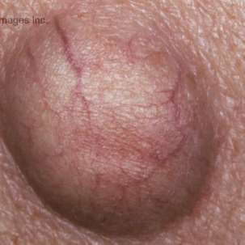
1. History of swelling
Swelling
Onset, course, duration?
Painful or painless?
Other lumps?
Effect on general condition?
Cause?
Does the lump disappear

Slide 65
2. Examination of a swelling
Inspection - Site, size, Shape, Symmetry, surface, skin overlying, scars
special signs e.g. pulsations, cough impulse, movements, association with swallowing
Palpation - Tenderness, skin temperature, size, surface (smooth, irregular, nodular), edges (well defined, ill defined), consistency (cystic or solid, soft or hard), relationship to surrounding structures (skin, muscle, arteries, nerves), draining lymph nodes, special signs

Slide 66
Consistency of the swelling
Cystic – Fluctuation, Paget’s test (a solid tumour is most hard in the center, where as a cyst is least hard at its center)
Solid – soft, firm, indurated, hard

Slide 67
A lump’s relationship to skin
Is the lump separate from the surrounding skin? – Pinch the skin over the lump
Is the lump tethered or fixed to the skin? – move the lump an see what happens

Slide 68
A lump’s relationship with muscle
Feel the swelling before an after muscle contraction
Is the swelling superficial, within, or deep to the muscle

Slide 69
Other specific diagnostic signs of lumps
Pulsations – expansile or transmitted
Transillumination – e.g. in hydrocele or cystic hygroma
Neck lumps – thyroid gland/thyroglossal cyst, lymph nodes
Hernias – cough impulse, reducibility

Slide 70
Percussion and Auscultation
Percussion – dull or resonant
Auscultation – Essentially over arteries and pulsating masses – listen for bruit

Slide 71
Conclusion Definition, background and classification of surgery
Outline of taking history of surgical pt
Outline of doing a PE of a surgical pt
Common surgical symptoms and signs
Evaluation of pain symptom
Evaluation of a swelling

Slide 72


